Slide 1

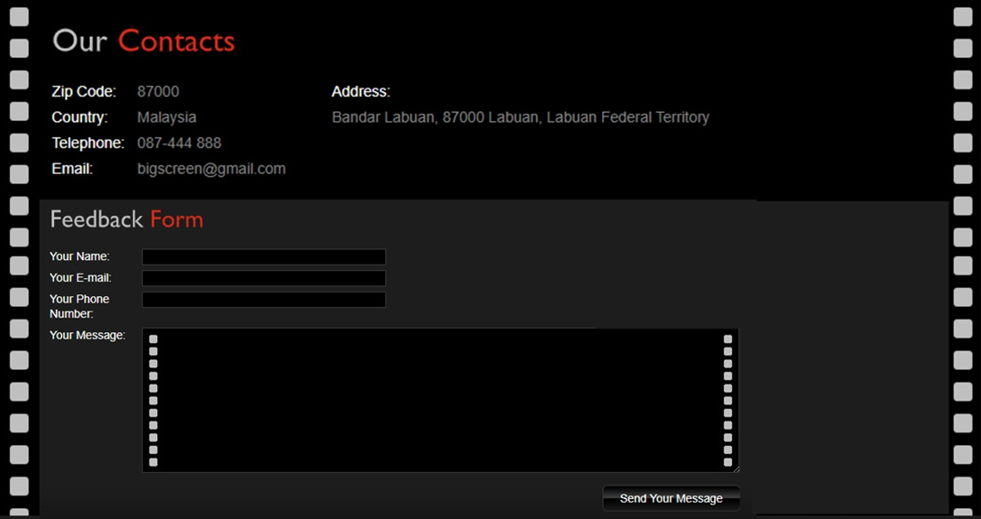

Slide 2
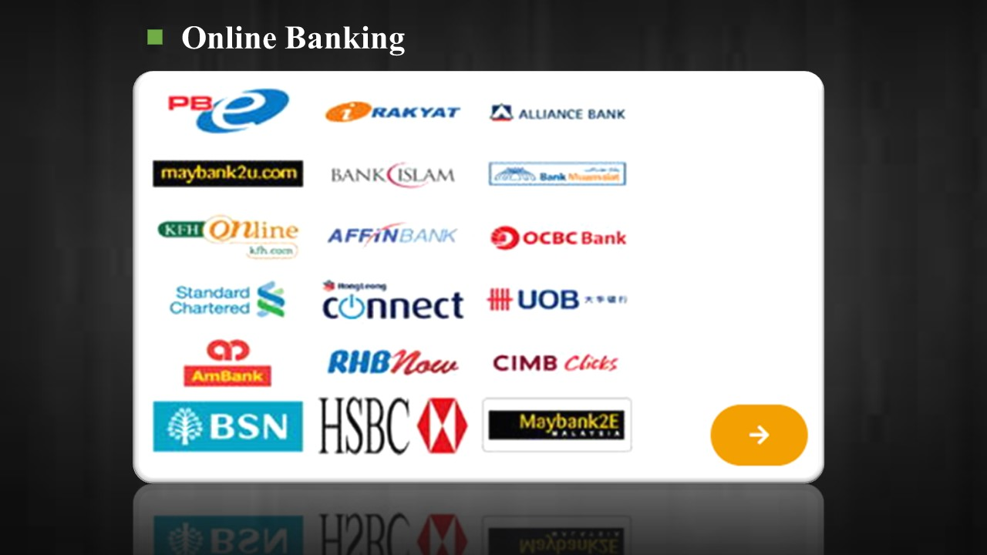

Slide 3
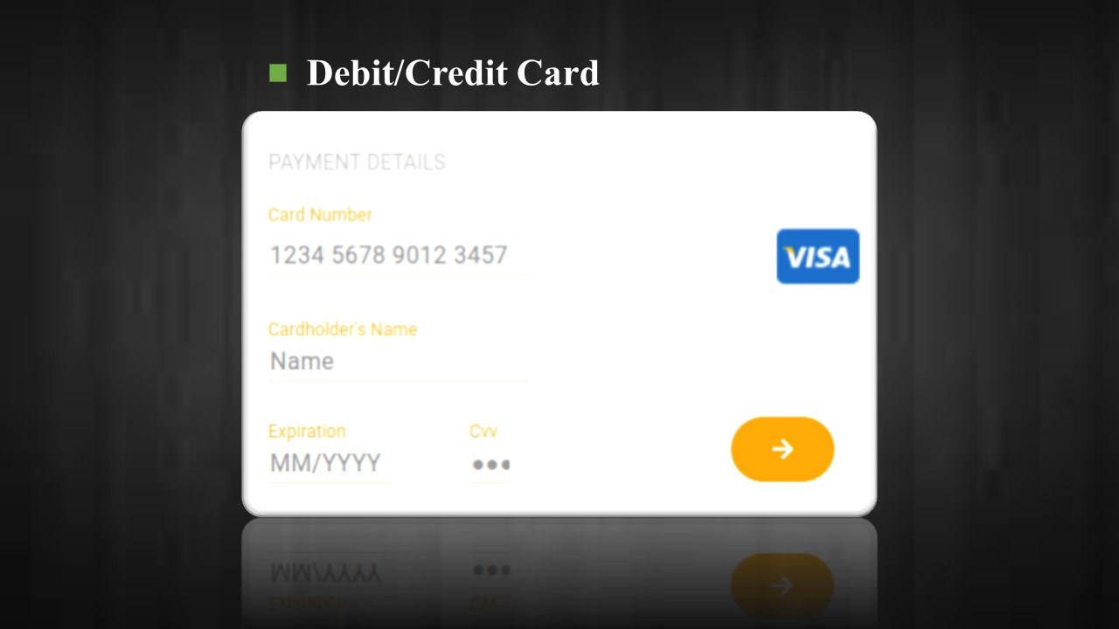
PAYMENT DETAILS
Card Number
1234 5678 9012 3457
Cardholder Name
Name
Expiration
CVV
MM/YYYY

